Slide 1
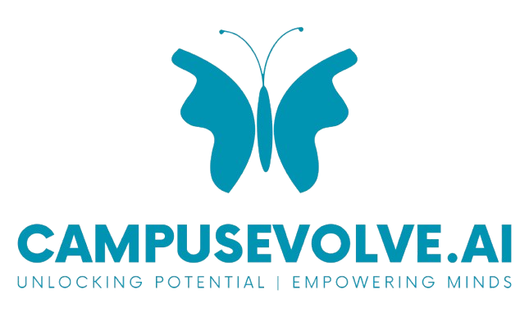
Student Pathway Completion Risk & Early Intervention Analytics
Unlocking Potential | Empowering Minds
By Ishan Joshi
Seattle, WA · github.com/nishaanjoshi0 · linkedin.com/in/ishannjoshi

Slide 2

Starting with the mission
CampusEvolve exists to improve economic mobility through education. Before building anything, I started with four business questions:
Production ML + Agentic AI
Are students actually achieving economic
mobility through education?
Who is falling off the pathway and why?
Are interventions reaching the students who need them most?
Are certain student groups being systematically left behind?

Slide 3
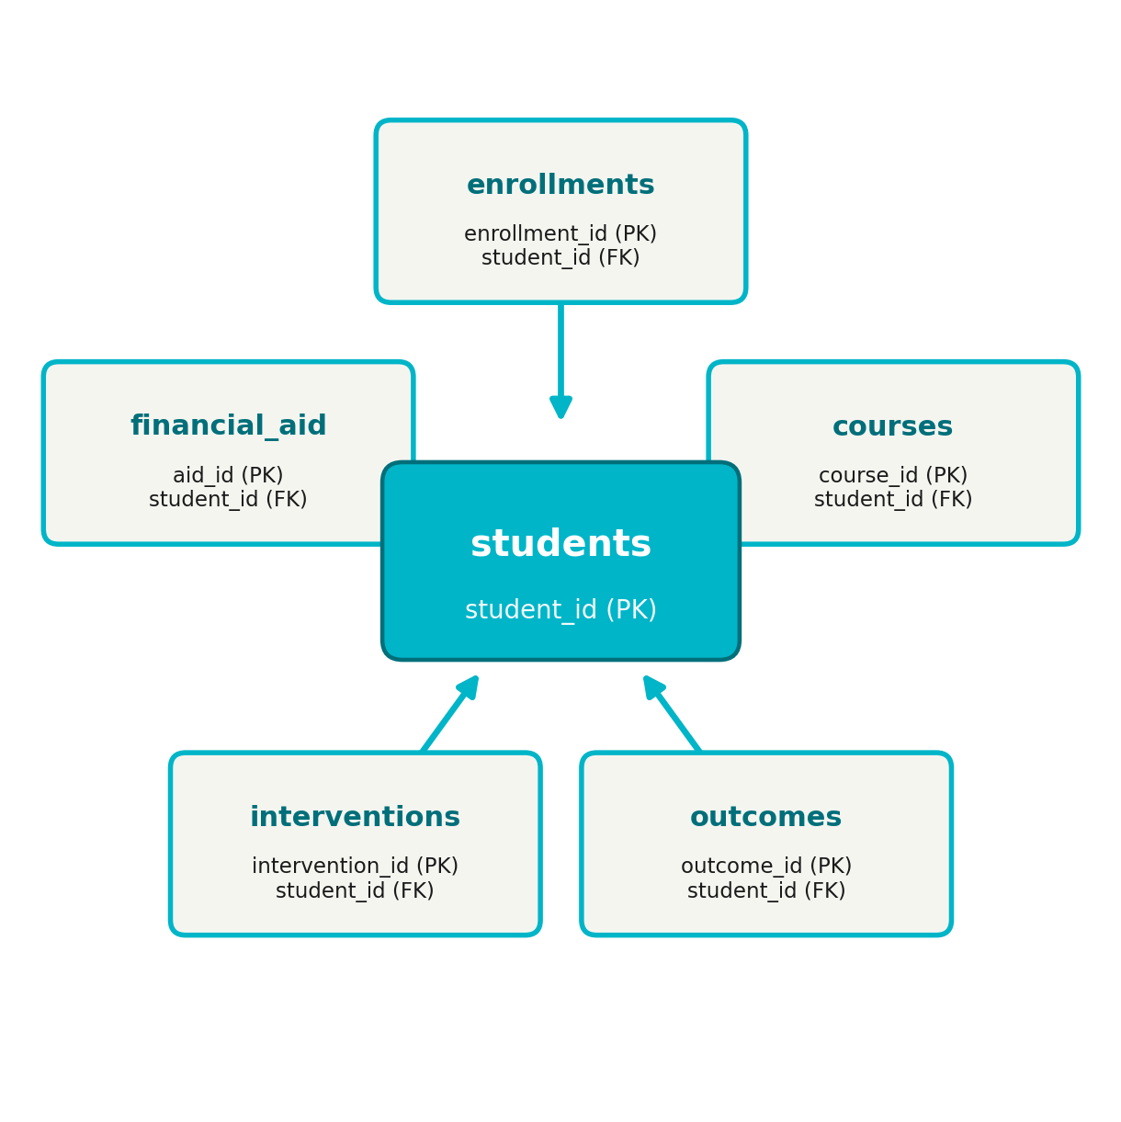
The dataset I used
To demonstrate this analytics framework, I built a fully synthetic dataset modeled on real IPEDS and NCES public education data. The dataset powers an interactive Power BI dashboard and a machine learning model, both available at: github.com/nishaanjoshi0/campusevolve-pathways-analytics
Star Schema
50,000 students
6 interconnected tables
841,000+ Course Records
219,000+ Enrollment Records
5 Enrollment Years (2018–2022)
4 Risk Signal Types

Slide 4
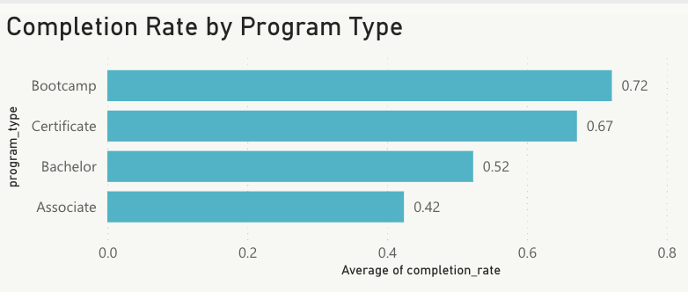
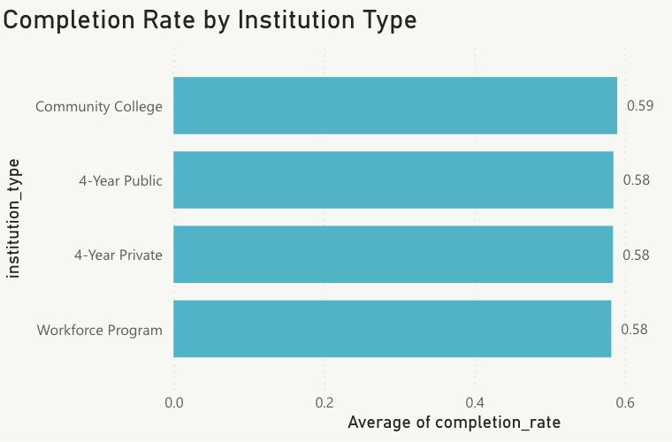
Who completes and why?
Bootcamp and Certificate programs have the highest completion rates at 72% and 67% respectively, while Associate programs lag at 42%. Notably, institution type shows almost no variation, all four types cluster around 58-59%.
Recommendation: Invest more resources in supporting Associate and Bachelor students through their programs. Shorter credential programs like Bootcamp and Certificate already perform well. The biggest opportunity to move the needle is in the longer programs where dropout is highest.

Slide 5
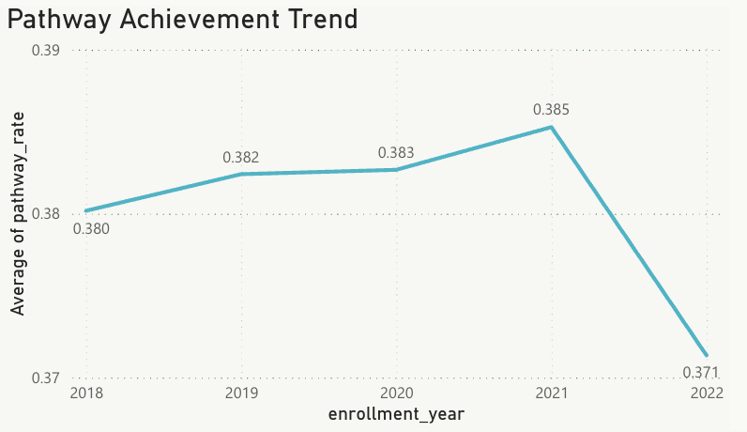
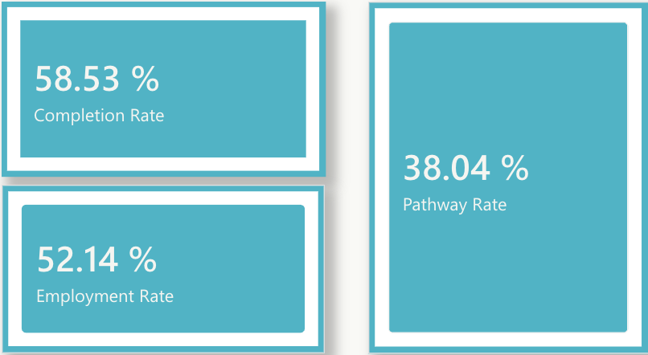
Is the mission improving over time?
Pathway achievement held steady between 38-38.5% from 2018 to 2021 before dipping in 2022. The dip is not a performance decline; it reflects recent enrollees who simply haven't had enough time to complete their programs yet. Only 38% of students achieve the full pathway of completing their program and finding employment within 6 months.
Recommendation: Pathway achievement has been flat at 38% for 4 years. To move this number, the focus should be on converting the 42% who complete their program but don't find employment within 6 months. Career services, employer partnerships, and job placement support are the highest leverage interventions here.

Slide 6
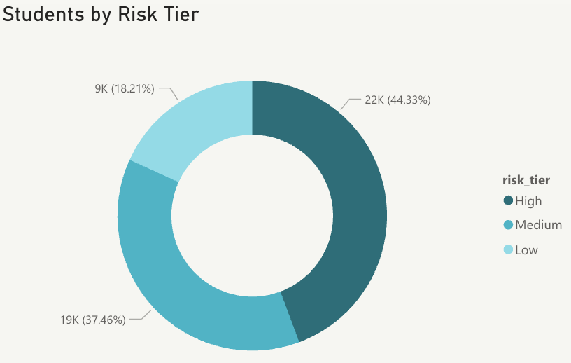
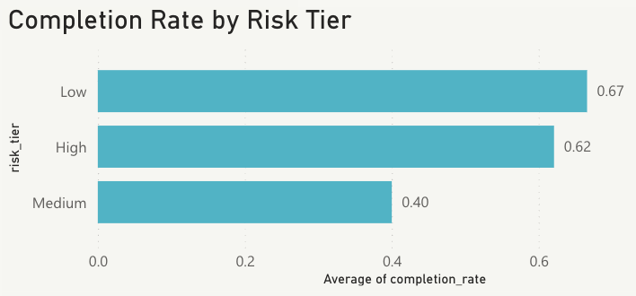
Who is at risk?
44% of students fall into the High-risk tier based on four early warning signals: GPA below 2.0, mid-semester withdrawal, financial aid gap, and gateway course failure. Counterintuitively, High risk students complete at 62% while Medium risk students only complete at 40%, suggesting current interventions are reaching High risk students but Medium risk students are being overlooked.
Recommendation: Shift intervention resources toward Medium risk students. High risk students are already being reached. Medium risk students are slipping through with almost no support, and their 40% completion rate shows it. Catching them earlier would have the biggest impact on overall completion rates.

Slide 7
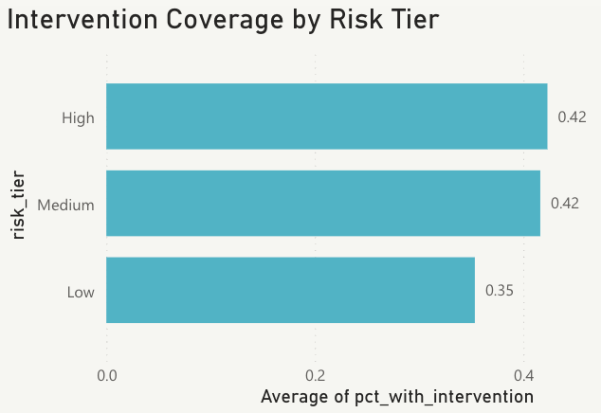
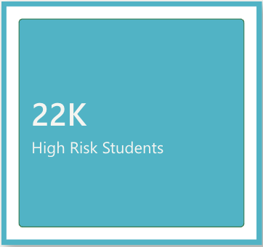
Are interventions working?
High and Medium risk students both receive interventions at 42% coverage, while Low risk students receive interventions 35% of the time. This means more than half of all at-risk students receive no intervention at all. The 22,163 High risk students represent the most urgent gap.
Recommendation: More than half of at-risk students receive no intervention at all. Expanding coverage should be the top priority before optimizing what type of intervention is delivered. Even a single touchpoint meaningfully improves outcomes.

Slide 8
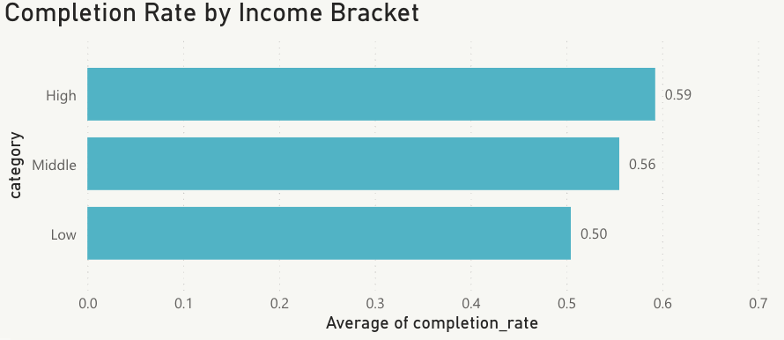
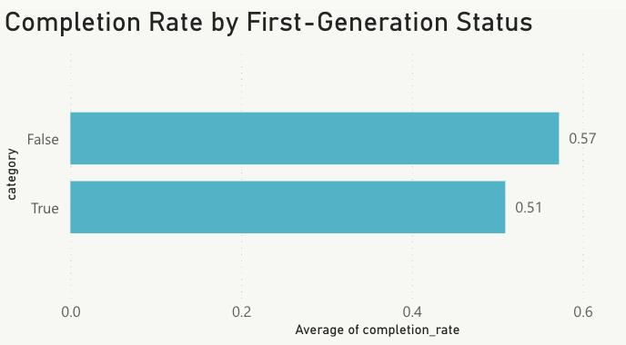
Are certain groups being left behind?
Low-income students complete at 50% vs 59% for high income students, a 9 point gap. First-generation students complete at 51% vs 57% for continuing-generation, a 6 point gap. Both gaps compound over time into long-term economic disadvantage.
Recommendation: Introduce proactive financial aid counseling and early advising for low-income and first-gen students in their very first semester, before any risk signals appear. Waiting for warning signs is too late for these groups.

Slide 9
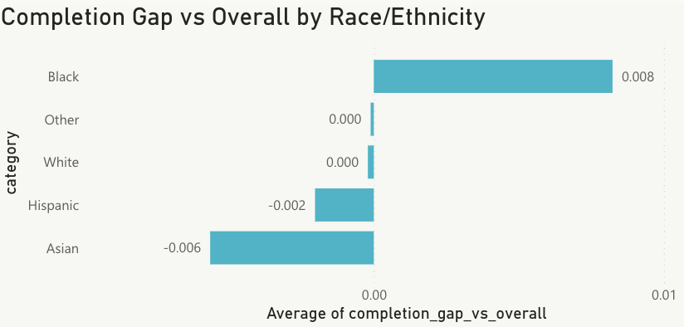
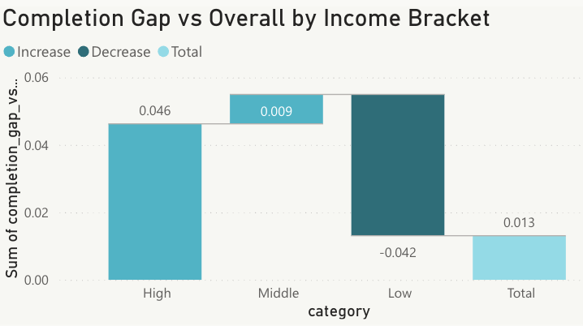
Race & Ethnicity alongside Income brackets
Race alone shows almost no completion gap. Asian and Hispanic students perform slightly below average but the gaps are less than 1 percentage point. When you compare this to the 9-point income gap, it becomes clear that income and first-gen status are the true underlying drivers of inequity, not race independently.
Recommendation: Equity interventions should be targeted by income and first-gen status rather than race. This approach will be more effective and more defensible to partner institutions and funders.

Slide 10
Predicting Dropout Risk with Machine Learning
Logistic Regression
AUC: 0.9337
Model Inputs
XGBoost
AUC: 0.968
Cumulative GPA
Total withdrawals
Credits attempted
Financial aid gap flag
Gateway course failure
Intervention engagement score
Income bracket
Program type
First-generation status
Top 3 Dropout Risk Drivers
Total Withdrawals
Credits attempted
Program type: Bachelors
Recommendation: A student who withdraws from even one course, attempts fewer credits, and is enrolled in a Bachelor program is significantly more likely to drop out. This model can score every student in real time and flag them before it's too late.

Slide 11
Next Steps
Immediate (0-30 days)
Short Term (30-60 days)
Identify the highest risk student segments across current partner institutions and map them against existing intervention coverage gaps.
Pilot the dropout risk model on one partner institution dataset. Validate model performance against real outcomes and calibrate risk thresholds.
Medium Term (60-90 days)
Long Term (90+ days)
Build equity monitoring into the core analytics infrastructure. Track completion and employment gaps by income and first-gen status on a rolling basis.
Define a north star pathway achievement metric that is time-adjusted, equity-disaggregated, and reported to funders and partner institutions as the primary measure of mission success.

